Slide 1
Building a Real-Time Stock Market Data API with Predictive Analytics
Team Name : Members:
Vishnukanth S 21R254
Selvan AG 21A231

Slide 2
The Challenge
Design and implement a RESTful API that provides real-time stock market data along with predictive analytics.
The API should enable users to query current stock prices, historical data, and predictions.
The solution is intended for integration into trading platforms, financial apps, or research tools.

Slide 3
Project Overview
Our solution integrates FastAPI, Flutter, and LSTM neural networks to deliver real-time stock predictions.
The API is designed to be scalable and easily integrated into various financial applications.

Slide 4
Software Architecture
The system architecture includes:
- Flutter frontend for user interaction.
- FastAPI backend for handling API requests.
- LSTM model for making stock predictions.
The RESTful API supports real-time data processing and prediction capabilities.

Slide 5
LSTM Model Overview
The LSTM model architecture includes:
- Multiple LSTM layers to capture temporal patterns.
- Dense and Dropout layers to prevent overfitting.
The model is trained on historical stock data to predict future prices.
This predictive analytics can inform trading decisions.

Slide 6
Key Features of the App
- Stock ticker selection for flexibility.
- Real-time data querying and prediction display.
- Graphical representation of historical and predicted prices.
- Integration potential with trading platforms and financial research tools.

Slide 7
FastAPI Functionality
FastAPI processes requests by:
- Fetching historical data using yfinance.
- Applying the LSTM model to make predictions.
- Returning results including predicted prices, MSE, RMSE, and more.
The API is designed for real-time data handling and easy integration with other systems.

Slide 8
Live Demonstration
Watch the app in action as we demonstrate:
- Selecting a stock ticker.
- Fetching predictions in real-time.
- Interpreting the results for trading decisions.
The demo highlights the integration potential of the API with financial tools.

Slide 9
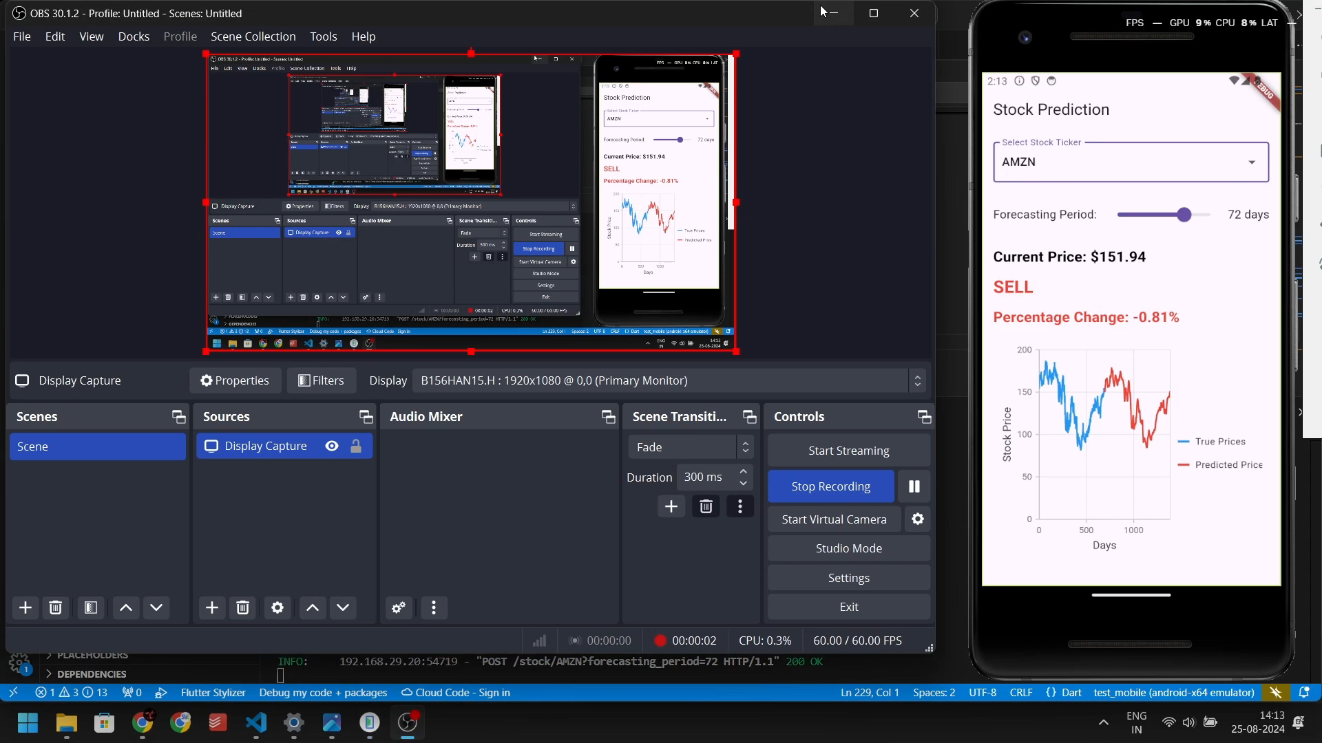

Slide 10
Future Enhancements
Possible future improvements include:
- Adding an attention mechanism to improve model accuracy.
- Enhancing the UI for better user experience.
- Integrating additional data sources for more comprehensive predictions.
Potential for broader integration with financial applications and tools.

Slide 11
Conclusion
This project demonstrates the power of combining machine learning with real-time data.
Our system provides valuable insights into stock market trends.
Future improvements will further enhance prediction accuracy and user engagement.
The solution's integration potential makes it suitable for trading platforms, financial apps, and research tools.

